Slide 1
Veritabanı yönetim sistemleri
Çetin erçelik

Slide 2
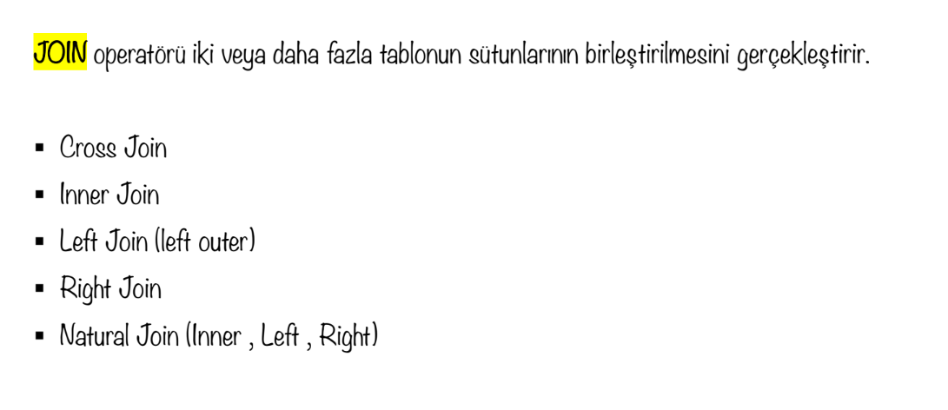
Joın

Slide 3
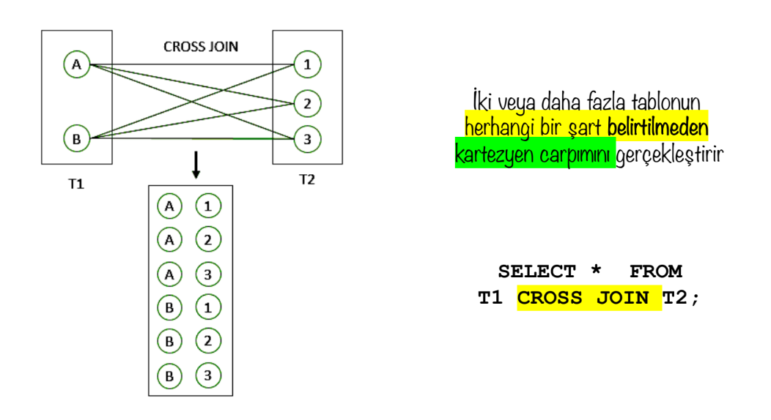
Joın: cross joın

Slide 4
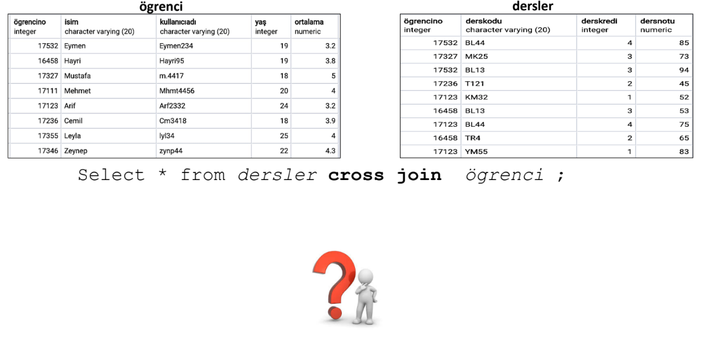
Joın: cross joın

Slide 5
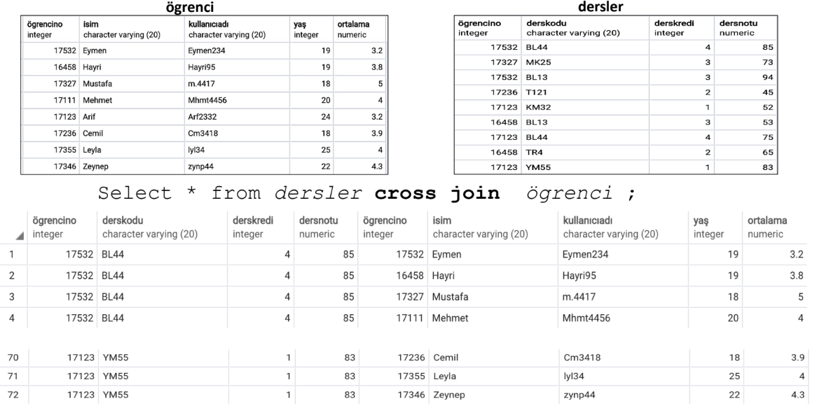
Joın: cross joın

Slide 6
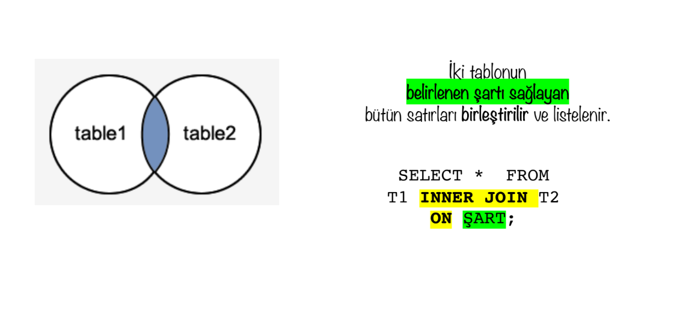
Joın: ınner joın

Slide 7
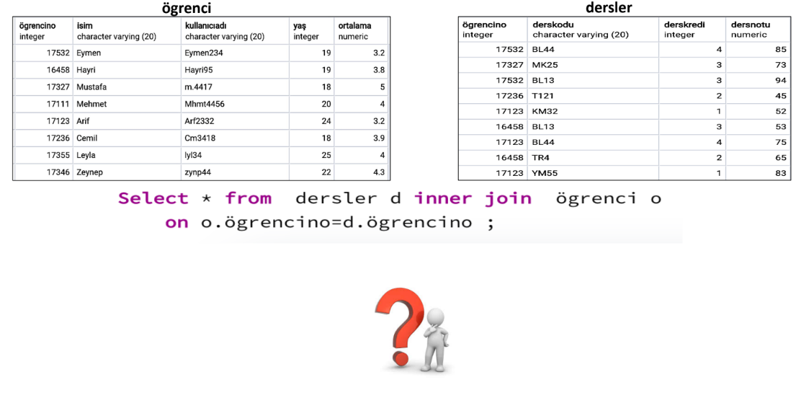
Joın: ınner joın

Slide 8
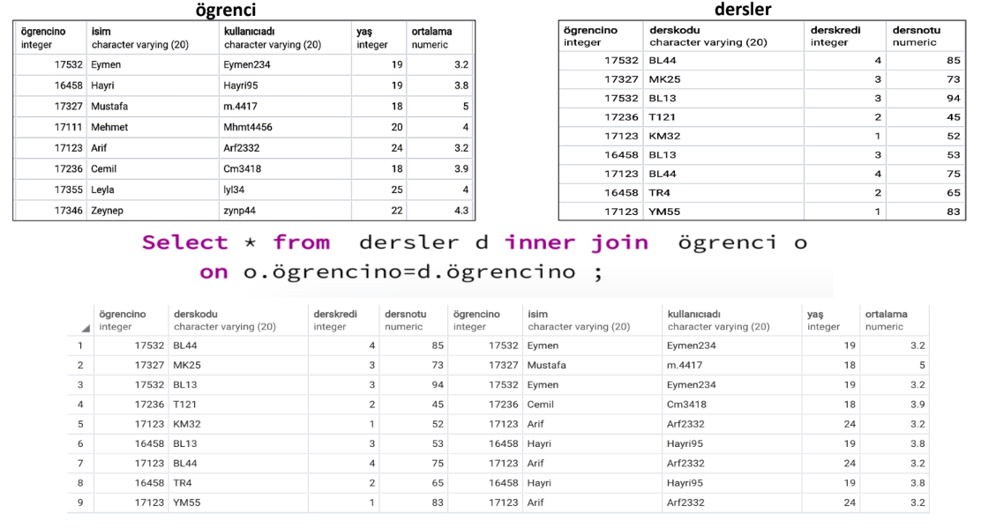
Joın: ınner joın

Slide 9
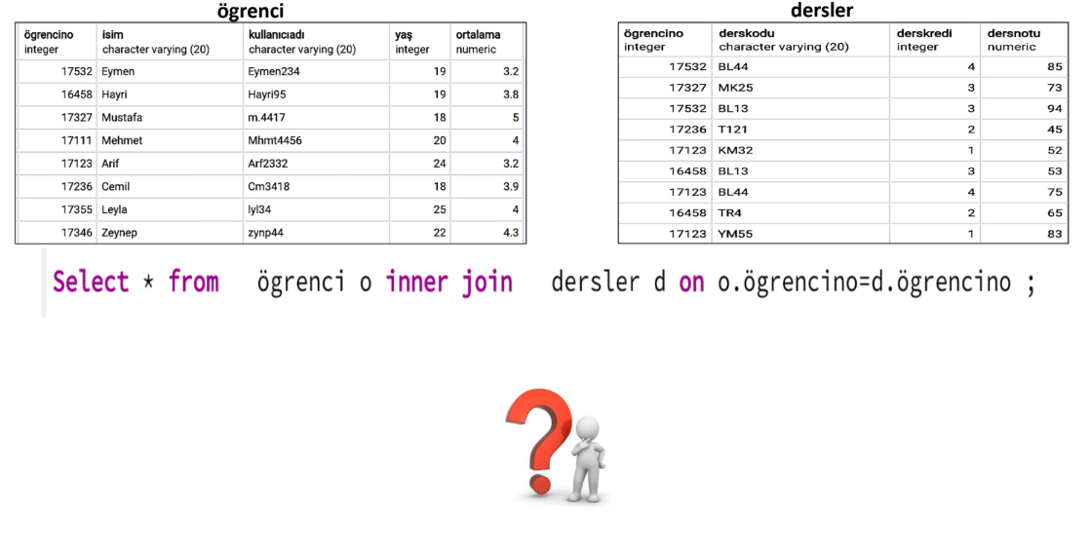
Joın: ınner joın

Slide 10
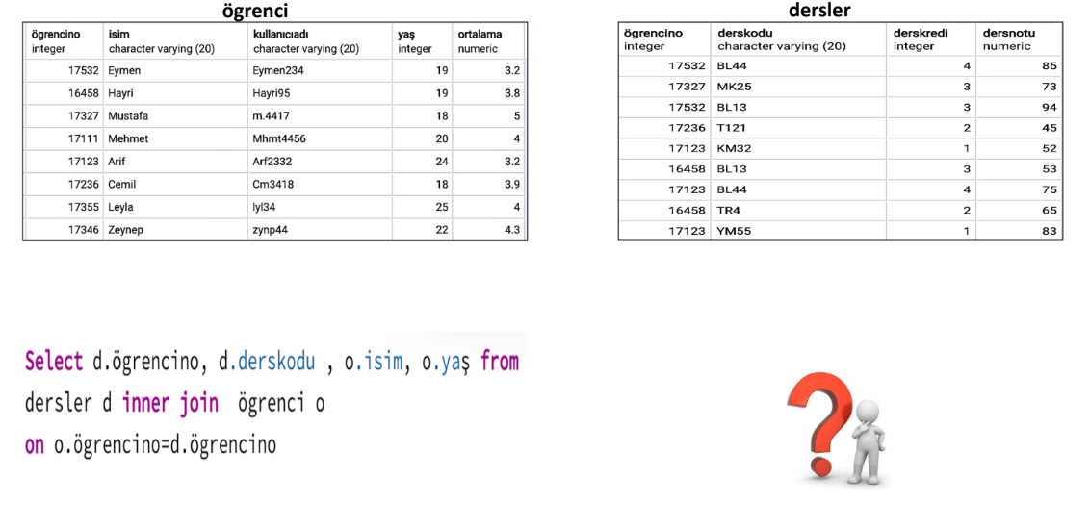
Joın: ınner joın

Slide 11
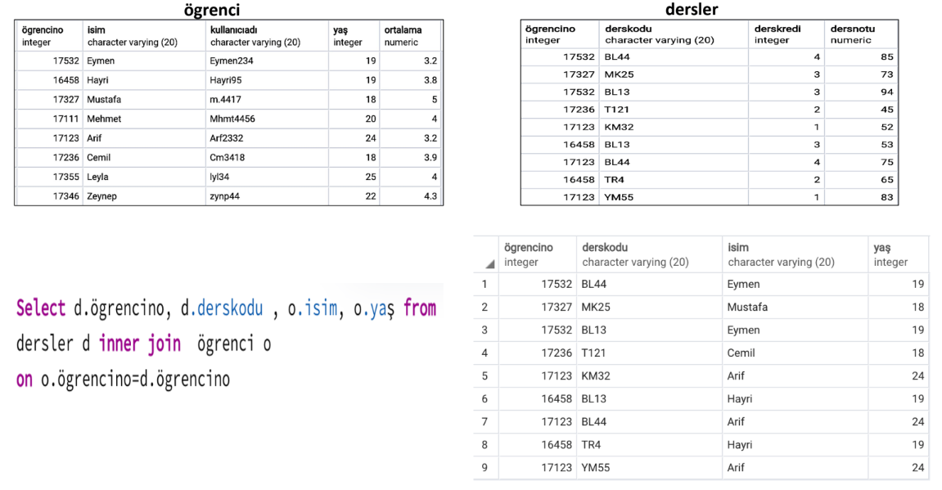
Joın: ınner joın

Slide 12
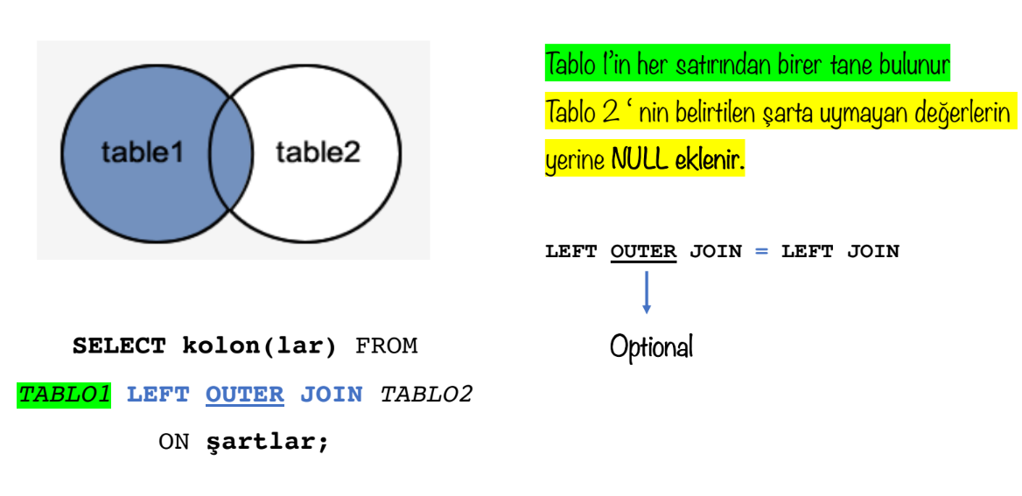
Joın: left joın

Slide 13
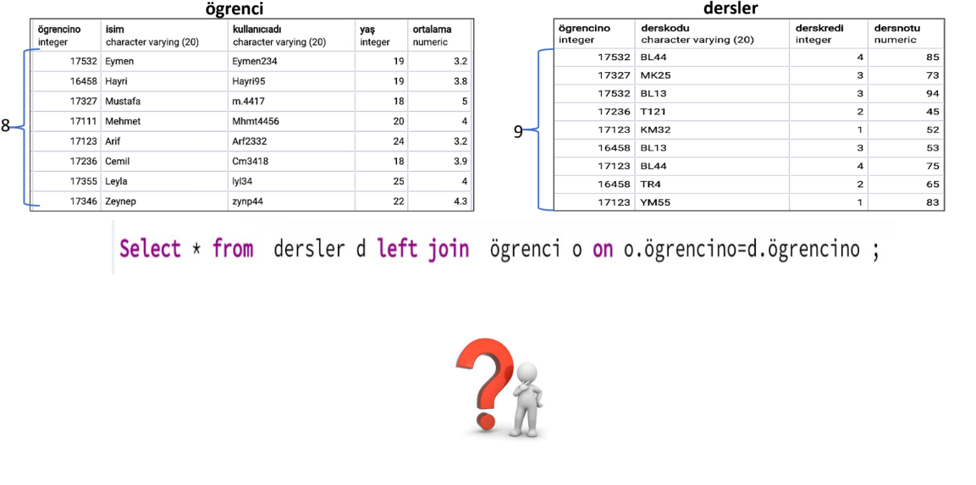
Joın: left joın

Slide 14
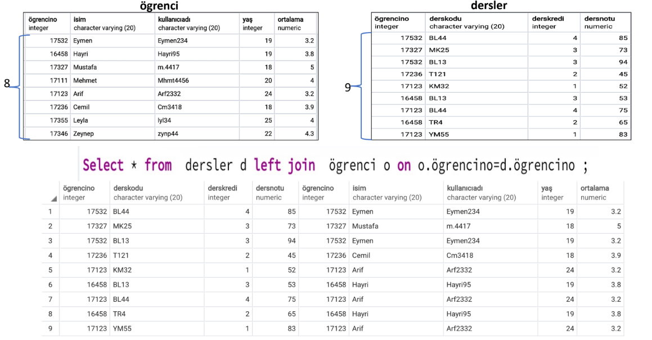
Joın: left joın

Slide 15
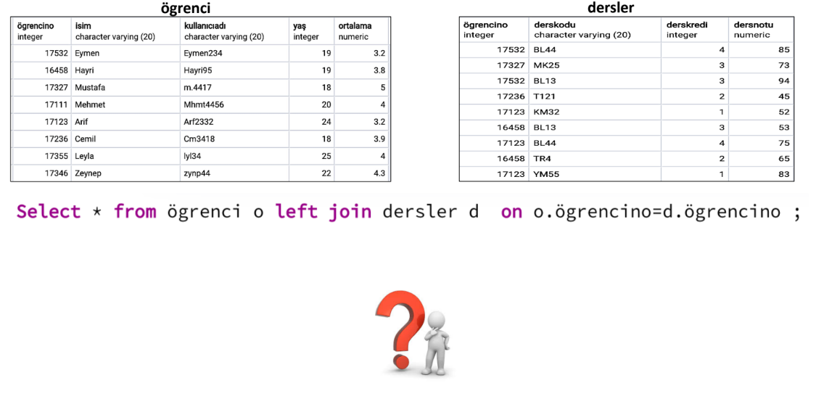
Joın: left joın

Slide 16
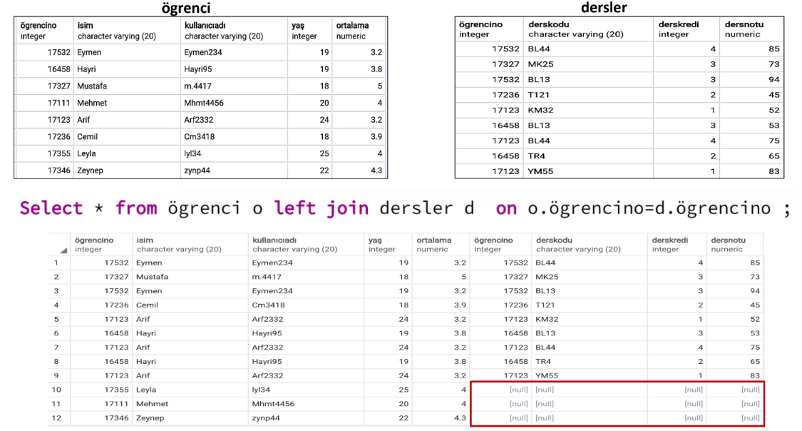
Joın: left joın

Slide 17
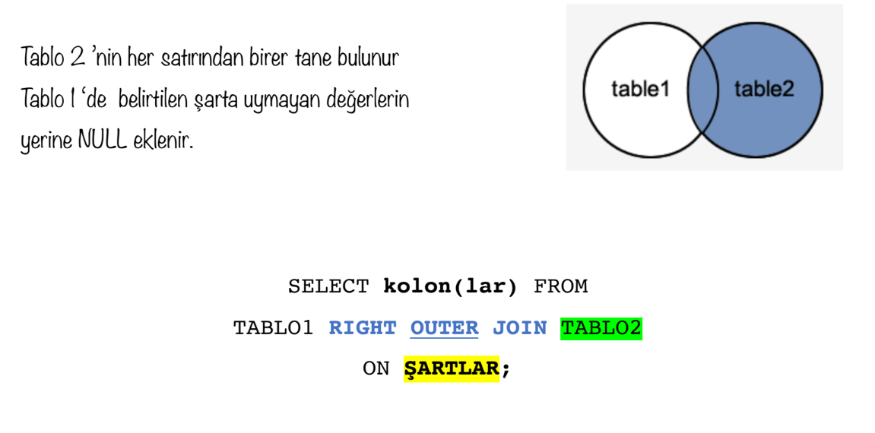
Joın: rıght joın

Slide 18
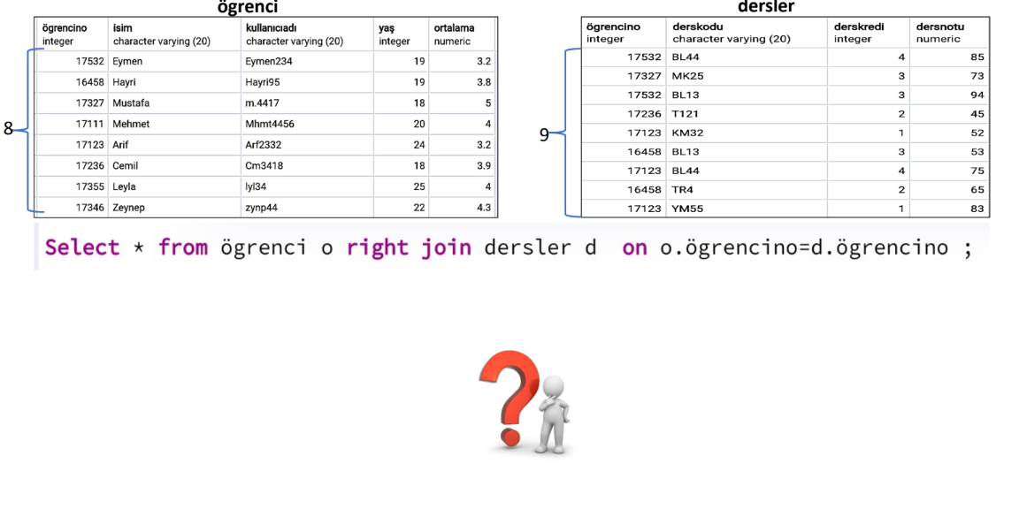
Joın: rıght joın

Slide 19
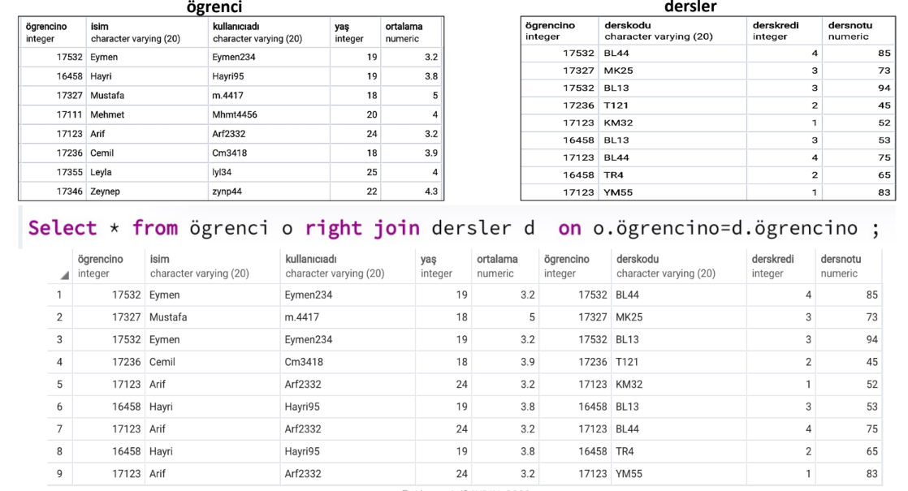
Joın: rıght joın

Slide 20
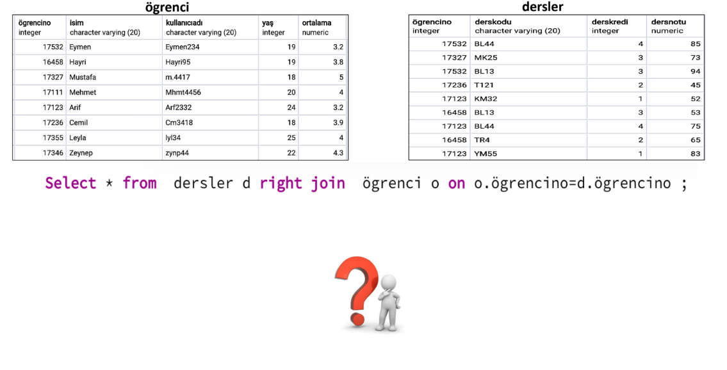
Joın: rıght joın

Slide 21
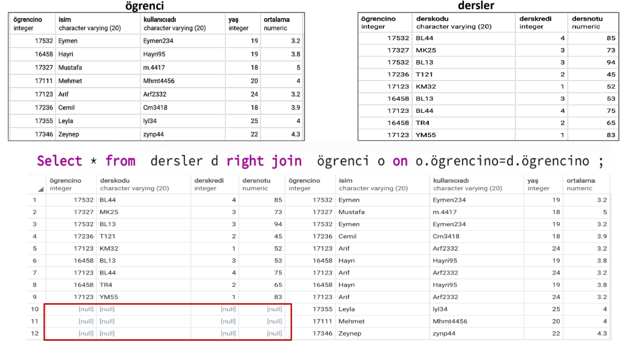
Joın: rıght joın

Slide 22
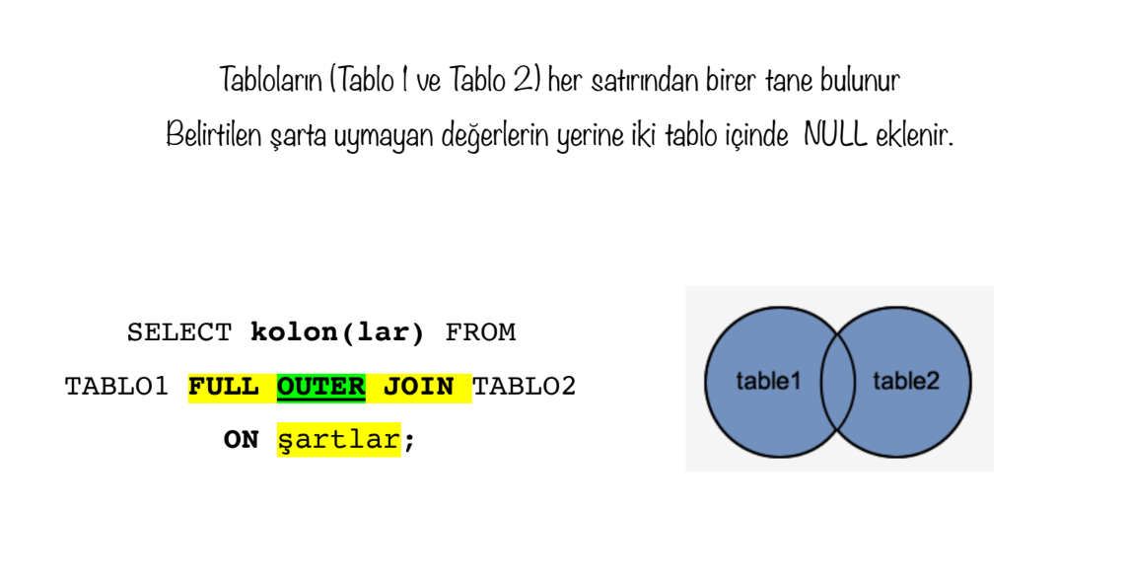
JOIN: Full Outer Joın

Slide 23
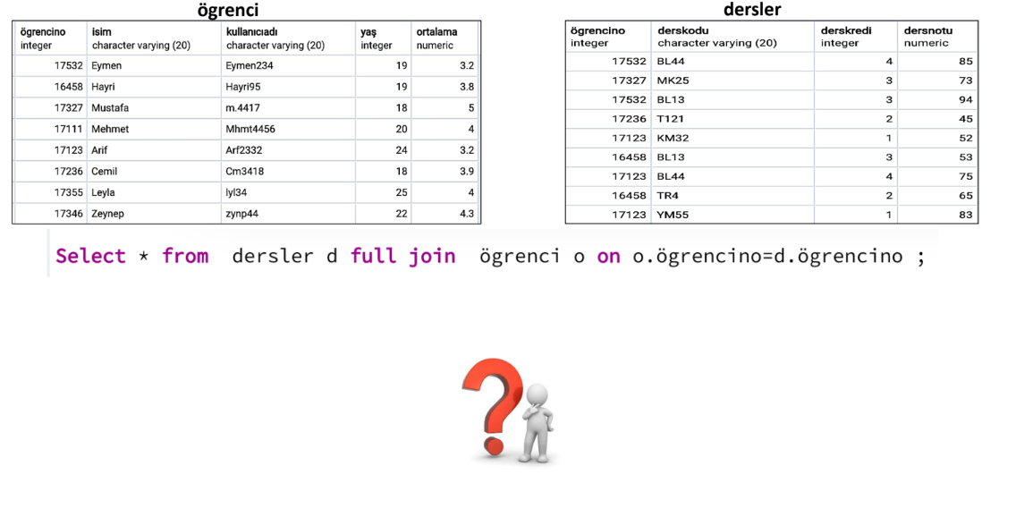
JOIN: Full Outer Joın

Slide 24
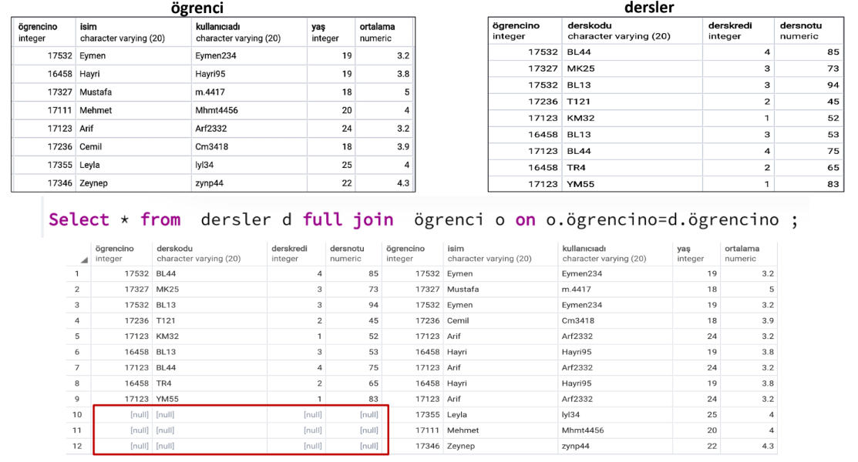
JOIN: Full Outer Joın

Slide 25
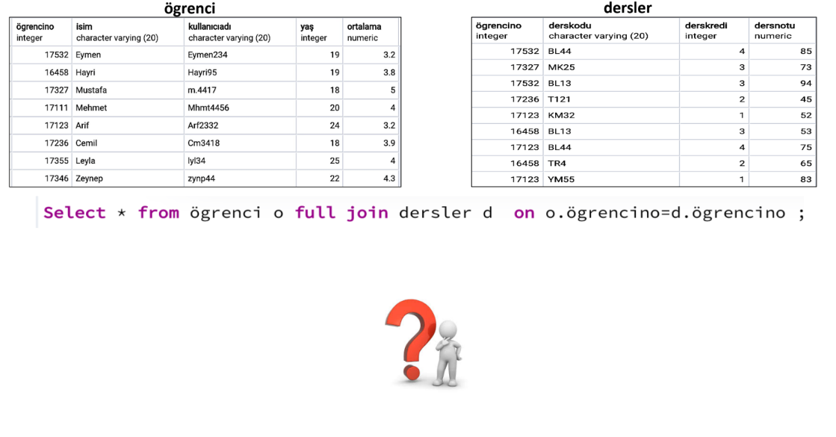
JOIN: Full Outer Joın

Slide 26
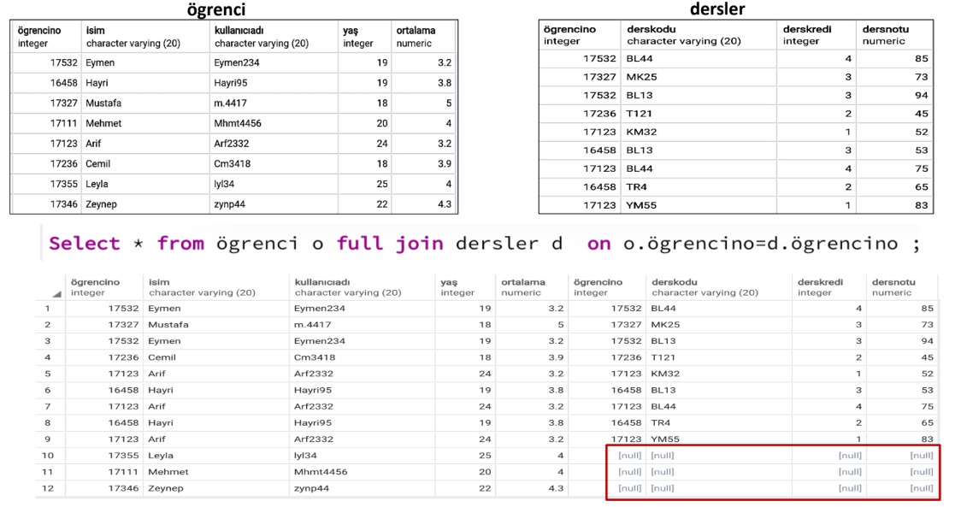
JOIN: Full Outer Joın

Slide 27
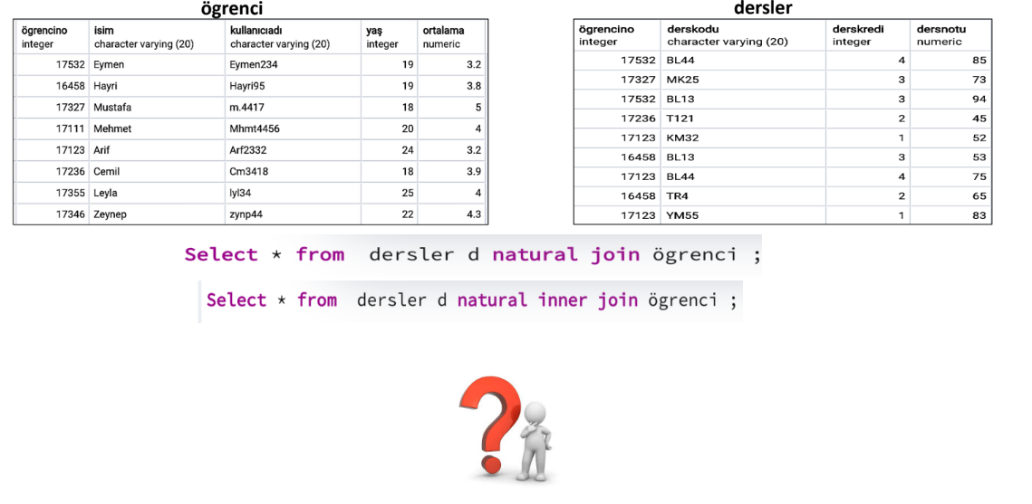
Natural Join (SELECT * FROM T1 NATURAL [INNER, LEFT, RIGHT] JOIN T2;)

Slide 28
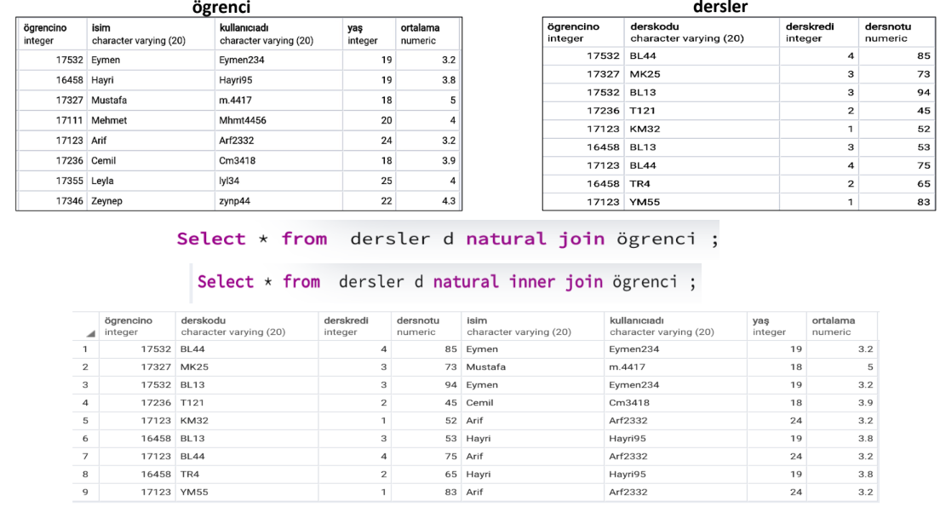
Natural Join (SELECT * FROM T1 NATURAL [INNER, LEFT, RIGHT] JOIN T2;)

Slide 29
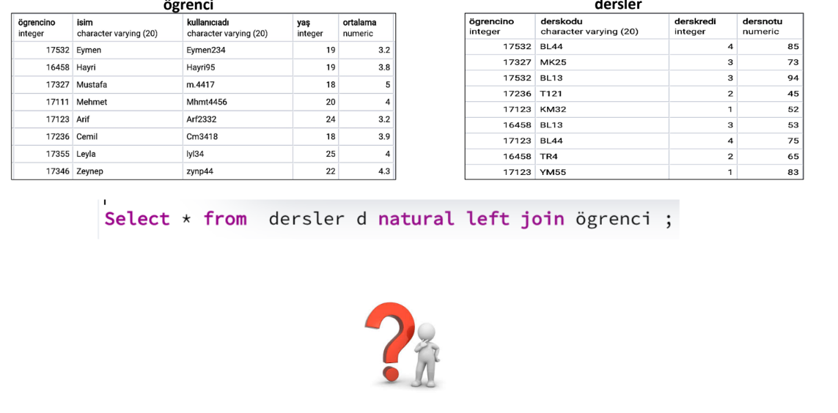
Natural Join (SELECT * FROM T1 NATURAL [INNER, LEFT, RIGHT] JOIN T2;)

Slide 30
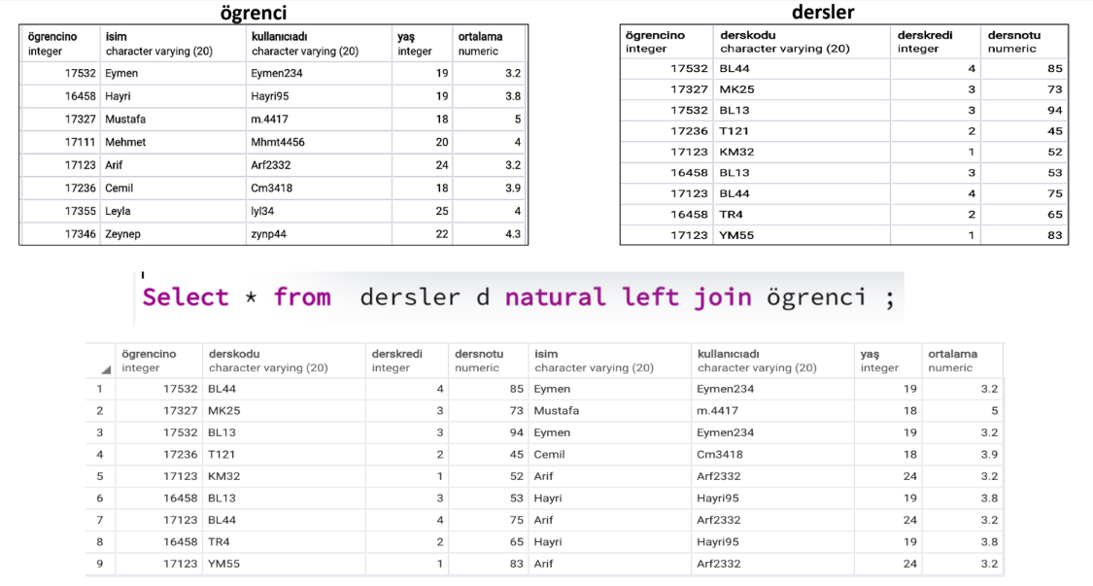
Natural Join (SELECT * FROM T1 NATURAL [INNER, LEFT, RIGHT] JOIN T2;)

Slide 31
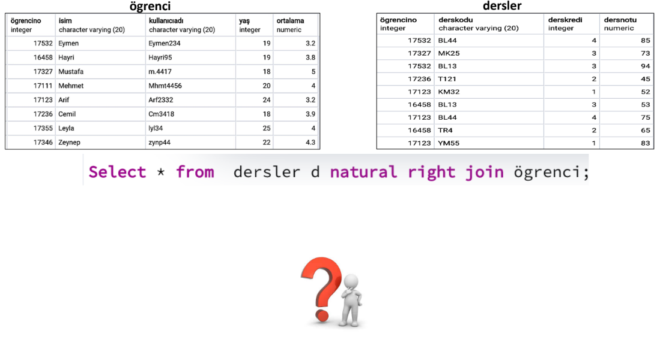
Natural Join (SELECT * FROM T1 NATURAL [INNER, LEFT, RIGHT] JOIN T2;)

Slide 32
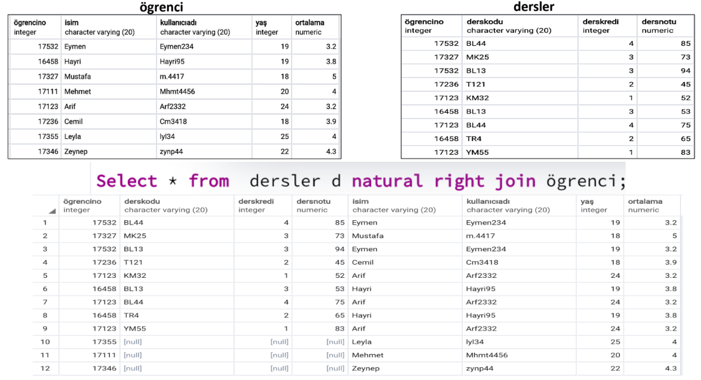
Natural Join (SELECT * FROM T1 NATURAL [INNER, LEFT, RIGHT] JOIN T2;)

